Slide 1
VGA
Video Graphics Array (VGA) is:
- a video display controller and
- a graphics standard
VGA signal timings are specified, published, copyrighted, and sold by the VESA® organization (www.vesa.org)

Slide 2
VGA Port (Basys 3)
The Basys 3 board uses 14 FPGA signals to create a VGA port with 4-bits per color and the two standard sync signals (HS – Horizontal Sync, and VS – Vertical Sync).
4096 different colors can be displayed, one for each unique 12-bit pattern.
A video controller circuit must be created in the FPGA to drive the sync and color signals with the correct timing in order to produce a working display system.

Slide 3
VGA
Video data typically comes from a video refresh memory. The controller must index into video memory as the beams move across the display and send video data to the display at precisely the time the electron beam is moving across a given pixel.

Slide 4
VGA
A VGA controller circuit must generate the HS and VS timings signals and coordinate the delivery of video data based on the pixel clock (25 MHz → 40 ns).
The VS signal defines the "refresh" frequency of the display (60 Hz)

Slide 5
VGA horizontal timing
Symbol | Parameter | Time | Clocks
T_{pw} | Pulse Width | 3.84us | 96
T_{bp} | Back porch | 1.92us | 48
T_{disp} | Display time | 25.6us | 640
T_{fp} | Front porch | 640ns | 16
T_{S} | Sync Period | 32us | 800
A VGA controller circuit must generate the HS accordingly with the table above.

Slide 6
VGA vertical timing
Symbol | Parameter | Lines | Time | Clocks
T_{pw} | Pulse Width | 2 | 64us | 1’600
T_{bp} | Back porch | 29 | 928us | 23’200
T_{disp} | Display time | 480 | 15.36ms | 384’000
T_{fp} | Front porch | 10 | 320us | 8’000
T_{S} | Sync Period | 521 | 16.7ms | 416’800
A VGA controller circuit must generate the VS accordingly with the table above. 1 line is 800 cc (an horizontal T_{S}). N.B.: We can count the lines!

Slide 7
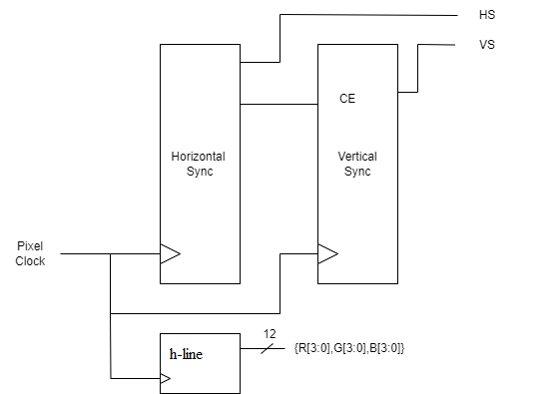
Esercizio: VGA controller 1
Realizzare un controller VGA che mostra una linea orizzontale che si muove dall’alto in basso. ( Sul simulatore eseguire: make run VGA=1)

Slide 8
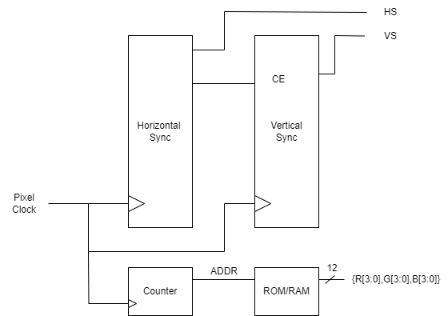
Esercizio: VGA controller 2
Realizzare un controller VGA che mostra un imagine memorizzata in una RAM/ROM sul simulatore eseguire (make run VGA=1)

Slide 9
RAM (Initialize Memory)
Verilog provides the $readmemh and $readmemb to load data in a memory array
module ram #(parameter N = 6, M = 32)
(input logic clk,
input logic we,
input logic [N–1:0] adr,
input logic [M–1:0] din,
output logic [M–1:0] dout);
logic [M–1:0] mem [2**N–1:0];
initial begin
$display("Loading data.");
$readmemh(“data.mem", mem);
end
always_ff @(posedge clk)
if (we) mem [adr] <= din;
assign dout = mem[adr];
endmodule

Slide 10
RAM (Initialize Memory)
We can also use initial to compute initial values
module ram #(parameter N = 6, M = 32)
(input logic clk,
input logic we,
input logic [N–1:0] adr,
input logic [M–1:0] din,
output logic [M–1:0] dout);
logic [M–1:0] mem [2**N–1:0];
initial begin
$display("Loading data.");
for (i=0; i<2**N; i++) begin
mem[i] = i;
end
end
always_ff @(posedge clk)
if (we) mem [adr] <= din;
assign dout = mem[adr];
endmodule

Slide 11
RAM (Initialize Memory)
hex_file.mem
// logic [7:0] ex2_memory [0:15];
// $readmemh("hex_file.mem", ex2_memory);
ab cd ef 01 // this is a comment
ef 22 1e 00
9f ff 13 e6
ce b7 28 8f
bin_file.mem
// logic [2:0] ex3_memory [0:15];
// $readmemh(“bin_file.mem", ex3_memory, 8,13);
001 101 111 111 101 001 // six 3-bit values
The hex_memory_file.mem or bin_memory_file.mem file consists of text hex/binary values separated by whitespace: space, tab, and newline.
You can define a start/end address.

